Slide 1
Climatic Regions of Pakistan

Slide 2
Climate of Pakistan
The atmospheric condition for a short period of time is called weather.
The average atmospheric condition for a long period of time usually 30 year is called climate.
Weather is the daily or day to day atmospheric condition it is changing hour to hour or day to day while climate is the average and takes hundreds, thousands, even millions of years to change.

Slide 3
Elements of weather condition
1 Temperature
2 Rain fall
3 Humidity.
4 Pressure
5 Wind

Slide 4
Factors that affect the climate of Pakistan
1 Altitude
Latitude location.
The sub-Tropical location of Pakistan that tends to keep the temperature high, particularly in summer.
3 Surface of the earth
5 Wind
6 Distance from the sea

Slide 5
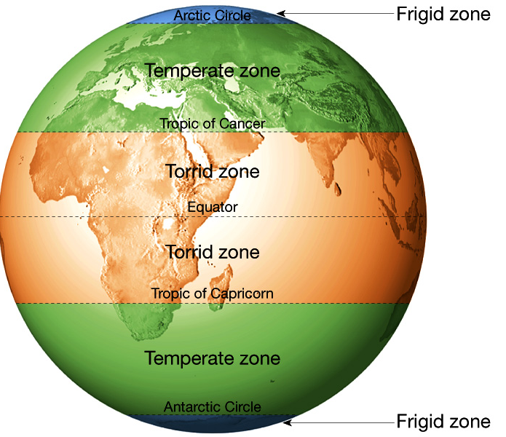
World Climate
Dr. R. B. Schultz

Slide 6
Sources of rain fall in Pakistan
1 Monsoon
2 Western depression

Slide 9
Climatic Regions Of Pakistan. Pakistan can be divided into the following climatic regions:
1.Sub-Tropical Continental Highland Type This region includes the mountains in the North and West of the Indus plain.
In this region winters are cold and lengthy and often the temperatures goes below the freezing point and the higher peaks remain snow -covered throughout the year. But here summer remains short cool.
The Western mountainous areas are less fertile and have barren rocks without any natural vegetation, and receive less rain fall then the northern and eastern mountain and receive more rain fall in winter then summer.

Slide 10
2.Sub-Tropical Continental Plateau Type This region includes the north western part of Baluchistan Province and Potwar region. Here winters are cold ,and in summer temperature goes higher enough and often dust storms prevail .Although it has higher altitude ,but due to poor rainfall these have turned into arid desert . In these areas there is lack of rain water and it is less than 10 inches or 25 cm annually ,but some of the places of these areas have the lowest rainfall e.g. Nokundi has only 1.95 inches or 5 cm of rainfall annually and rain often comes during the months of January and February

Slide 11
3.Sub-Tropical Continental Low Lands This region includes the interior areas of Punjab and Sindh provinces and Peshawar valley. It has generally arid and extreme climate.
Here summer remains long and hot but winters are cool and short.
It has the hottest places of the country such as Jacobabad and Sibbi.
The rainy season begins in the middle of the summer months.The places which are situated near pledmont areas have enough rainfall e.g. Sialkot has about 30 inches or 88.3 cm. of annual rainfall.
But the western part of this plain is drier than the eastern due to very poor rainfall e.g. Thal and Cholistan desert in Punjab and Tharparker desert in Sindh are included in this region.

Slide 12
4.Sub-Tropical Coastal Areas Type This region includes the coastal area around Karachi and Makran. Here due to the influence of the sea the temperature remains moderate the rainfall is about 7 inches or 18 cm annually .

